Slide 1




Isabel.
Camilio.
Nicole.
Diabetes
An Overview
Taking a look at the data.

Slide 2




Project Overview
How does change in insulin price compare to change in GDP?
In California, how does diabetes prevalence change over time?
In California, does a particular race have more diabetes than others?
Is California an outlier compared to other states in regard to diabetes prevalence?
How is diabetes death correlated with poverty, GDP, population, or employment?

Slide 3

SHORT BRIEF
Project
Overview
Taking a look at the trends and prevalence of diabetes over the years.
Project Goals
How does change in insulin price compare to change in GDP?
In California, how does diabetes prevalence change over time?
In California, does a particular race have more diabetes cases?
Is California an outlier compared to other states in regard to diabetes prevalence?
Does diabetes death correlated with poverty, GDP, population, or employment?

Slide 4




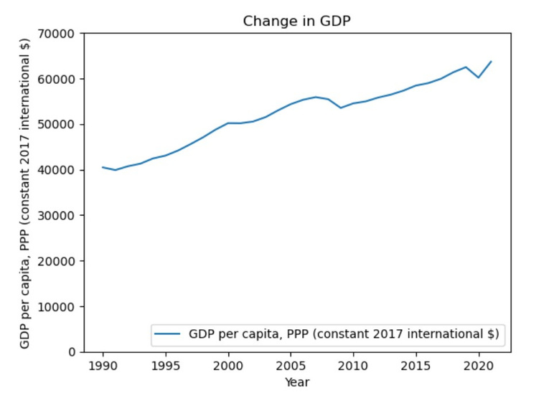
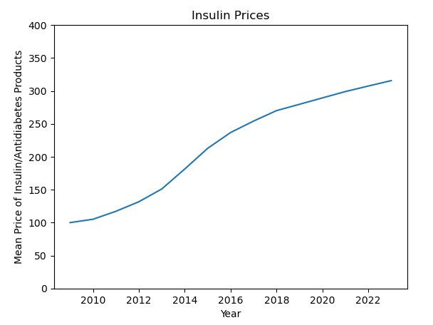
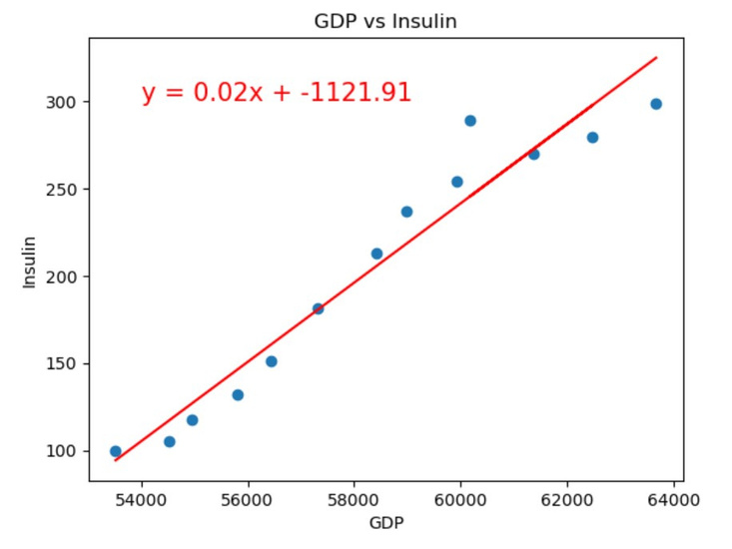
Insulin Price
vs. GDP
GDP per Capita has increased
from 1990 to 2020
Insulin/Antidiabetic products have increased
from 2010 to 2022
Strong correlation between
GDP and insulin prices
2010 - 2020

Slide 5

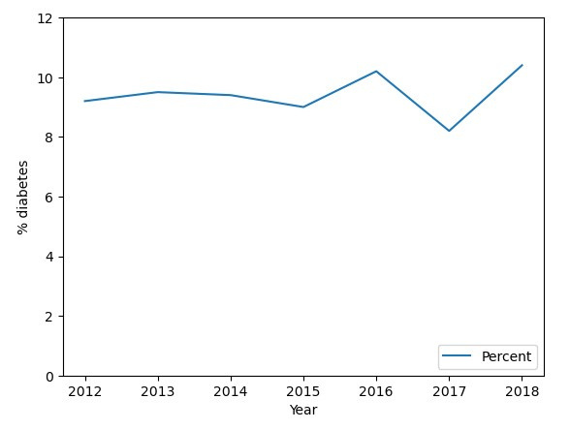

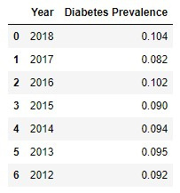

How does California diabetes prevalence change overtime?
2012 - 2018 California residents with diabetes

Slide 6
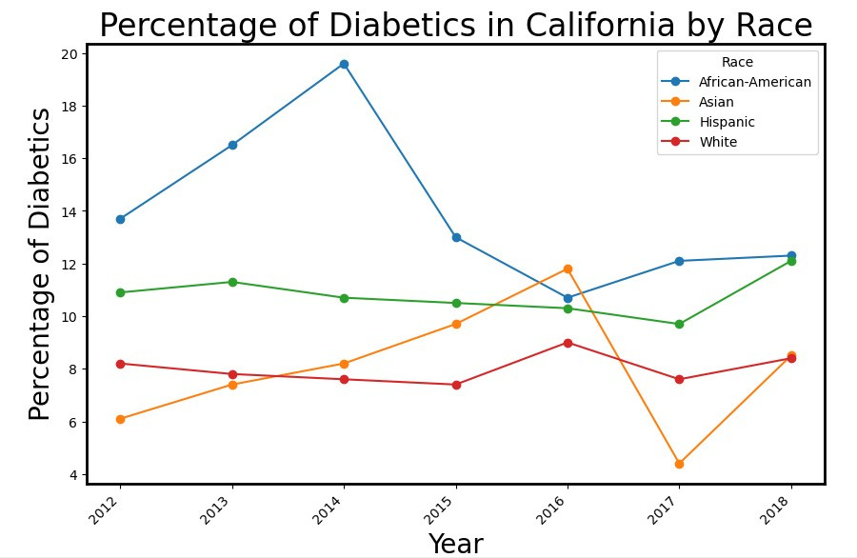
In California, does a particular race have more diabetes than others?
Target Audience #3
List their key details.

Slide 7
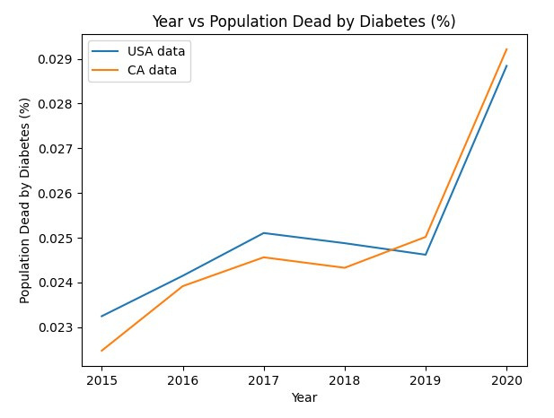
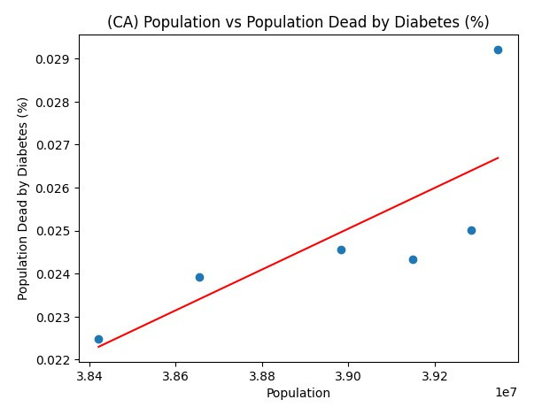

Is California an outlier compared to other states?

Slide 8




What Went
Overall, we're proud of the accomplishments of our team. Recognizing our successes is an essential aspect of our growth as a team, and we'll continue to build on these achievements.
Well
List the team's wins during the
duration of the project.
Successfully Met
Project Goals:
Efficient
Collaboration:
We're thrilled to report that we successfully met all project goals within the given timeframe.
Our team members worked cohesively, despite being in different time zones and locations.

Slide 9


What Did Not
While these issues had a negative
impact on the project, we learned
important lessons from them. Our team
is committed to applying these lessons
to future projects
Go Well
List the team's misses during
the duration of the project.
Delays Due to
Technical Issues:
Inadequate
Communication:
We encountered technical issues that caused delays and impacted the timeline of the project.
Communication breakdowns occurred between team members, which resulted in misunderstandings and delays in completing tasks.

Slide 10

Moving Forward
Summarize the team's points for
improvement and immediate action items.
Points for Improvement | Immediate Action Items | Key Person In Charge
Write here | Write here | Add team member
 |  | Add team member
 |  | Add team member
 |  | Add team member
 |  | Add team member

Slide 11
Thank you!
for participating!
Good work, team. Here's to more
improved practices for future projects.

Slide 12




Resource
Page
Use these design resources in your Presentation. Happy designing!
Delete or hide this page before presenting.

Slide 13


https://fred.stlouisfed.org/series/WPU06380103
https://ourworldindata.org/grapher/diabetes-prevalence-vs-gdp-per-capita
https://data.ca.gov/dataset/adults-with-diabetes-per-100-lghc-indicator
https://catalog.data.gov/dataset/weekly-counts-of-death-by-jurisdiction-and-cause-of-death
https://github.com/datamade/census
https://dof.ca.gov/reports/demographic-reports/american-community-survey/#ACS2018x1
Resource
PAGE

